Slide 1

Benefits Of Gaming

Slide 2

DONE BY
BATTIKH Khayriddine

Slide 3

OUTLINE
-WHY PEOPLE PREFER GAMING
-BENEFITS OF GAMING

Slide 4
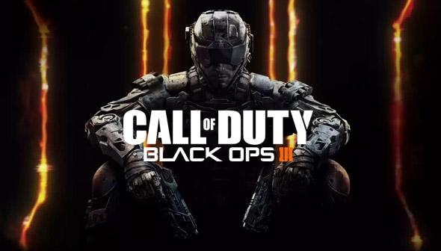


Slide 5

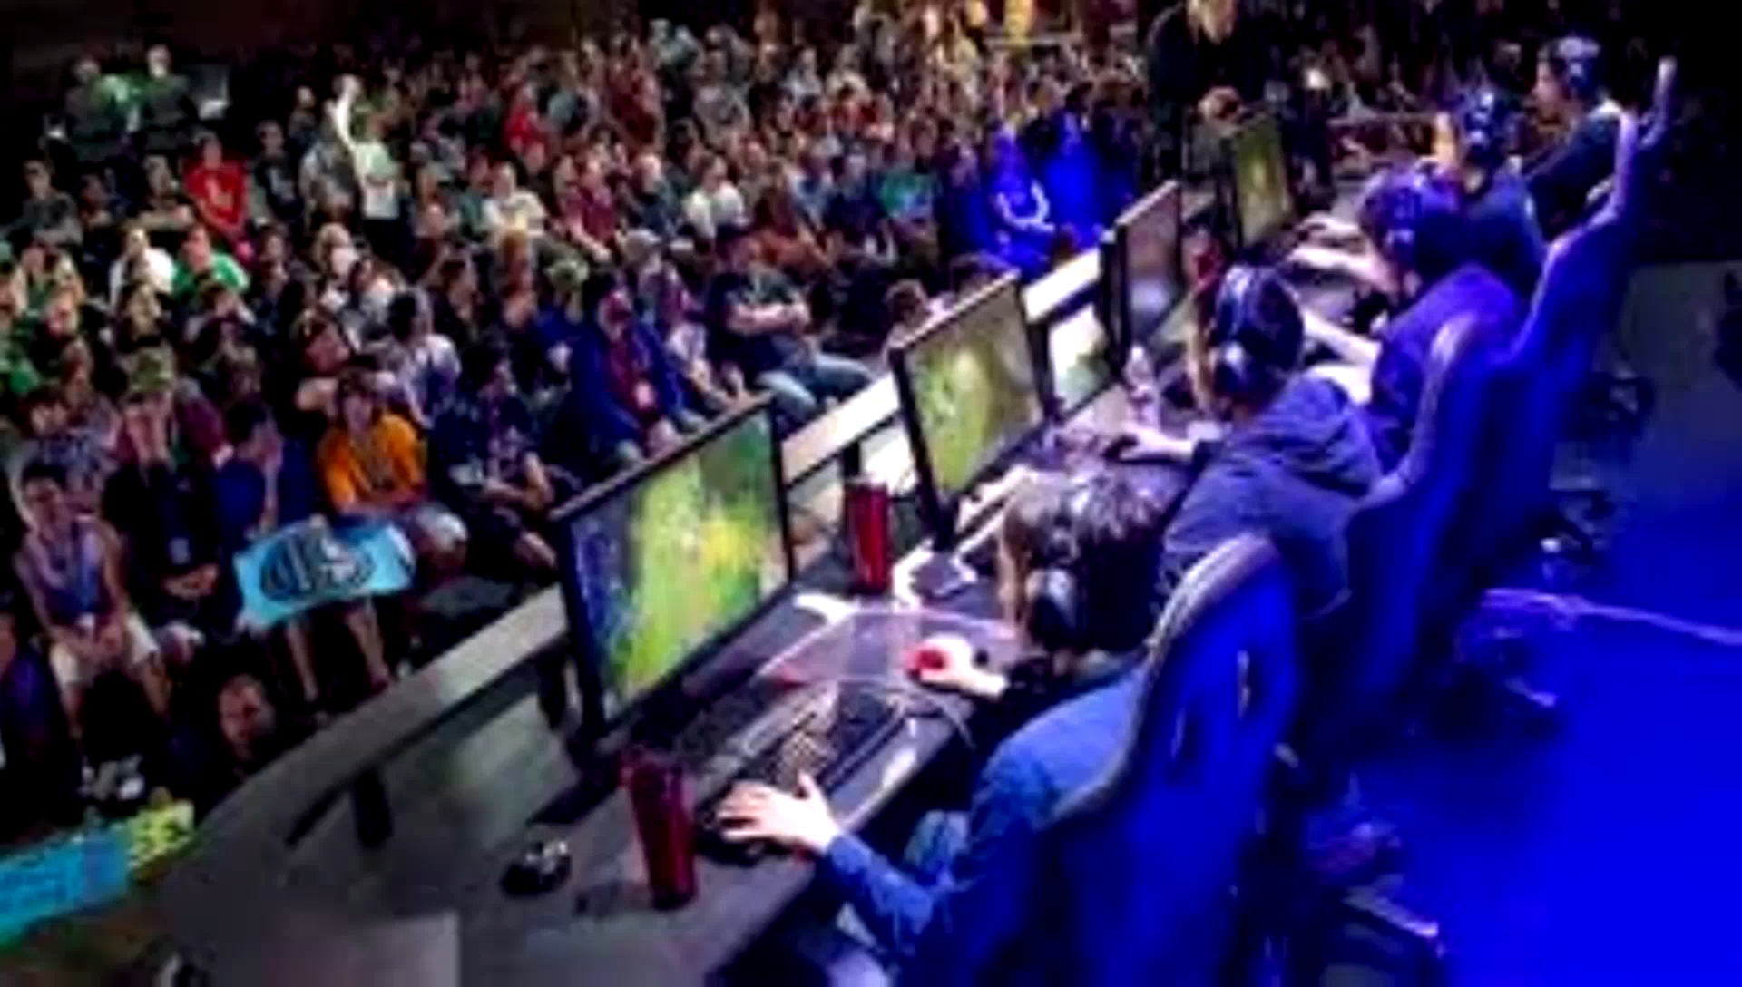

WHY GAMING ?
* The thing that make games more fun and attractive is the
SENSE OF ACHIEVEMENT NOT
THE VIOLENCE

Slide 6

Games are sets of restrictive rules designed to create an artificial challenge that requires specific application of skill to surmount.
PEOPLE ARE INCREDIBLY EAGER TO CHALLENGE THEMSELVES

Slide 7

-People are free to do whatever they to do and no one is going to judge them.
-Desire to beat high score.
-RPG’s allow players to create their own character and gives an emotional attachment to the character.
-The desire to find the clue and move to the next level.

Slide 8
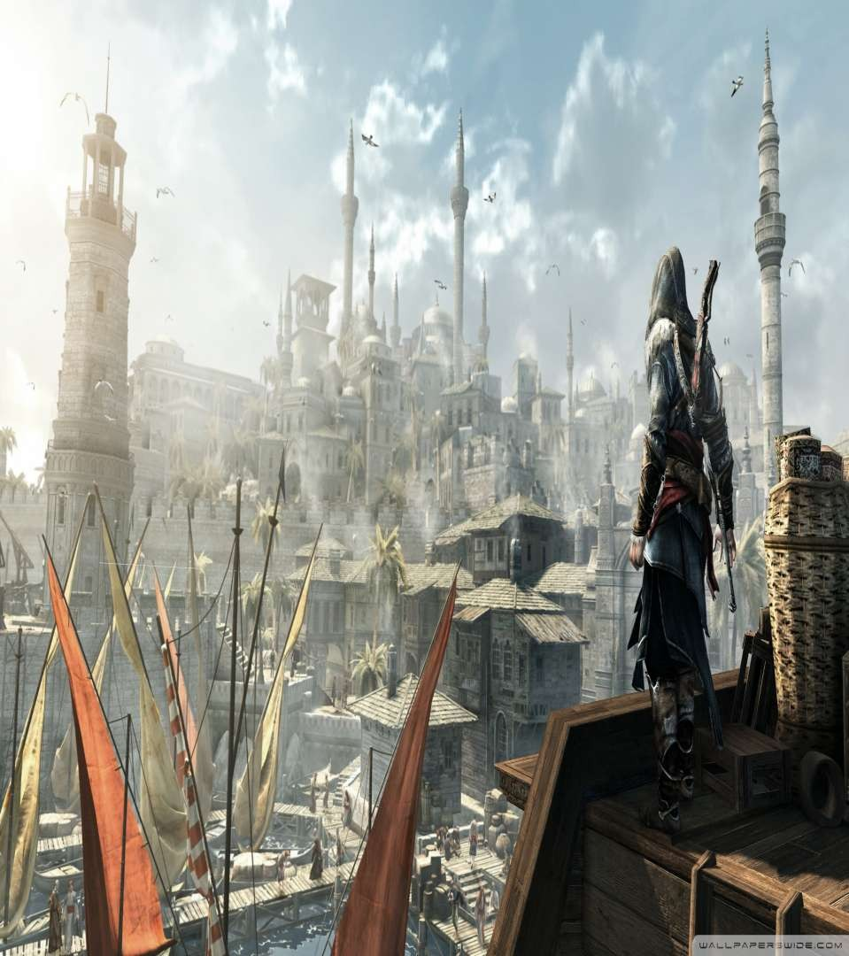
-Relationships provided by the online games.
-The thrill of discovering places . It allows one to explore new environments and they can interact with them.

Slide 9
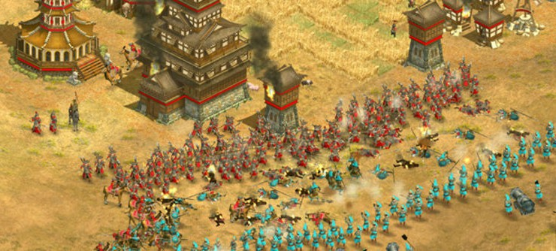
during the Battle of Ain Jalut in 1260, the Mamluks used cannon against the Mongols. He claims that this was "the first cannon in history" and used a gunpowder formula almost identical to the ideal composition for explosive gunpowder.

Slide 10


Daphne Bavelier
Daphne Bavelier is a professor at the University of Geneva,
she was a professor of brain and cognitive sciences
at the University of Rochester

Slide 11
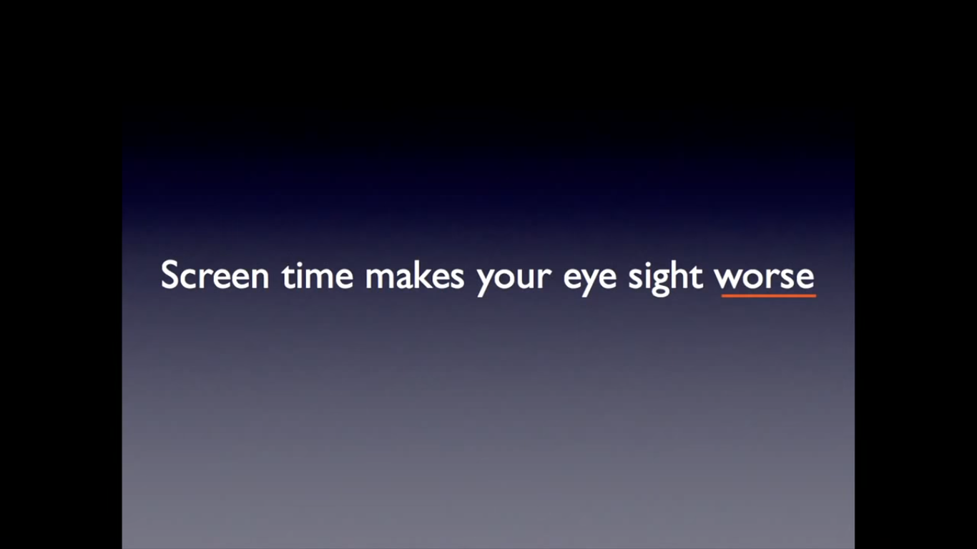

Slide 12
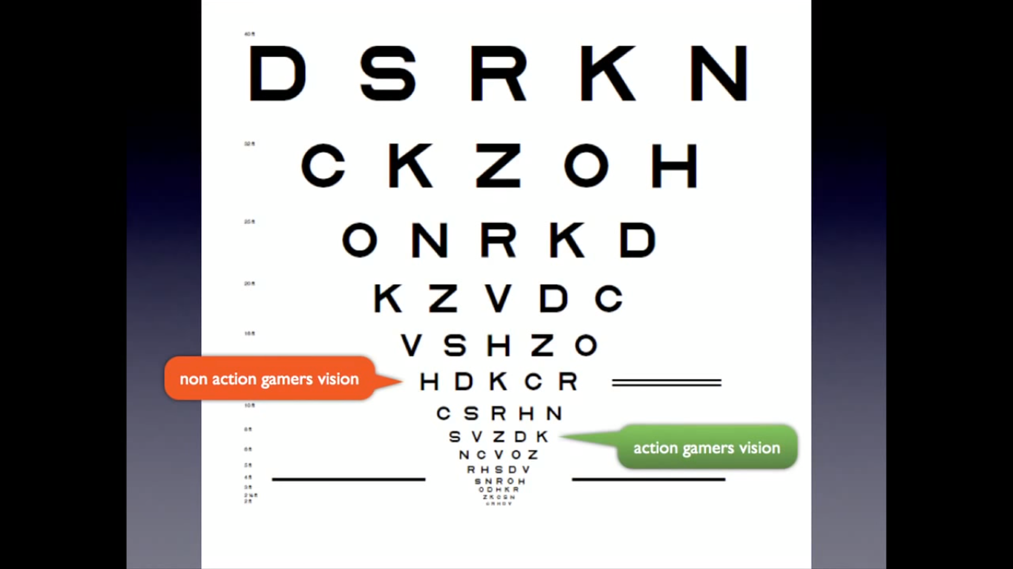

Slide 13


Slide 14

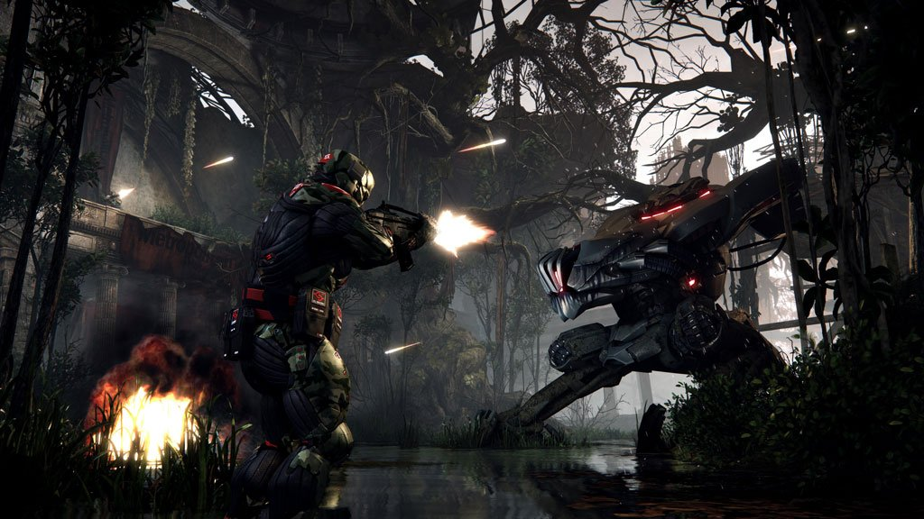
-Modern fast-paced action video games — in particular first-person shooter games — may sharpen your vision, improve your attention and working memory.

Slide 15
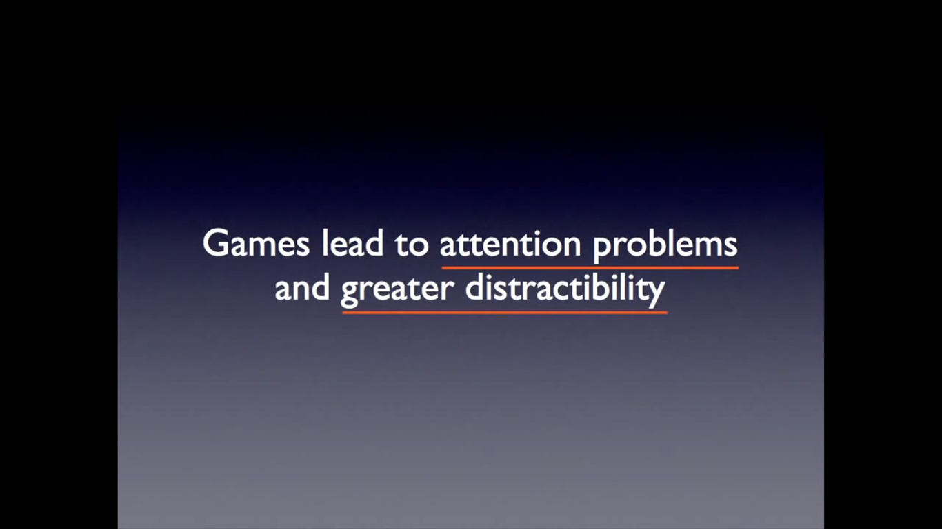

Slide 16


Slide 17

Skills achieved by gaming
-Brains are trained to do multitasking.
-Games can help adults process information much faster and improve their fundamental abilities to reason and solve problems.
-Enhance split-second decision

Slide 18
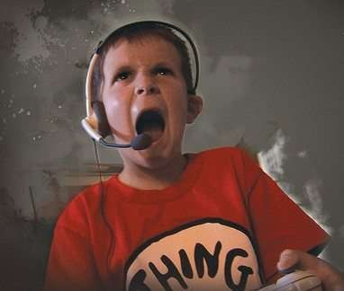
Improves fighting spirit.
GAMERS NEVER GIVE UP

Slide 19
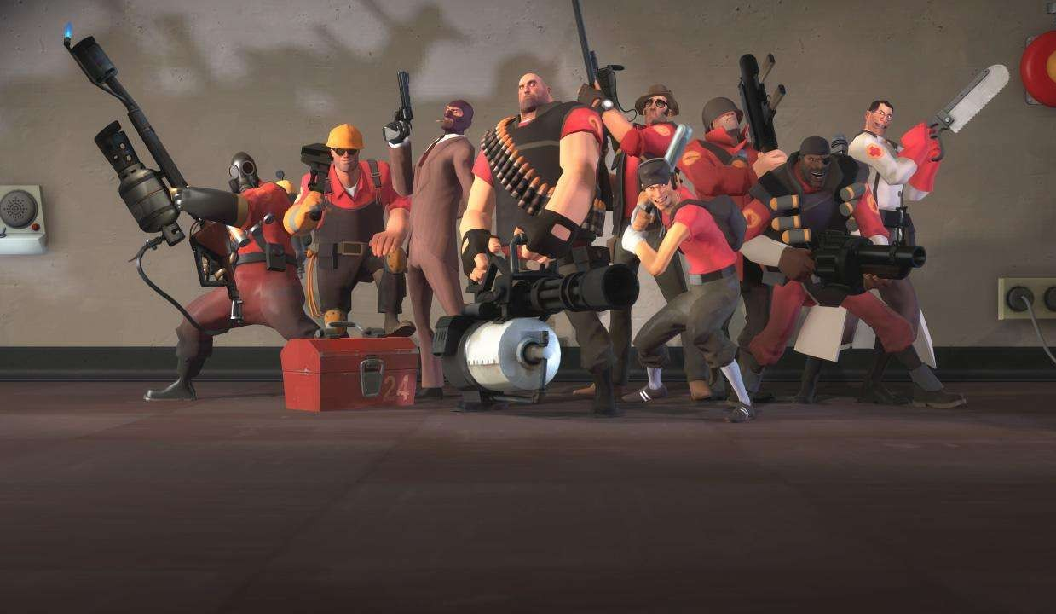
Encouraging Cooperation and Teamwork

Slide 20
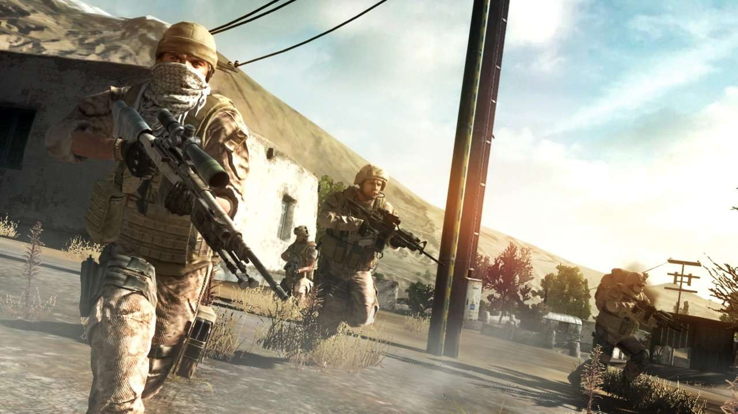
BUILDING CONFIDENCE

Slide 21
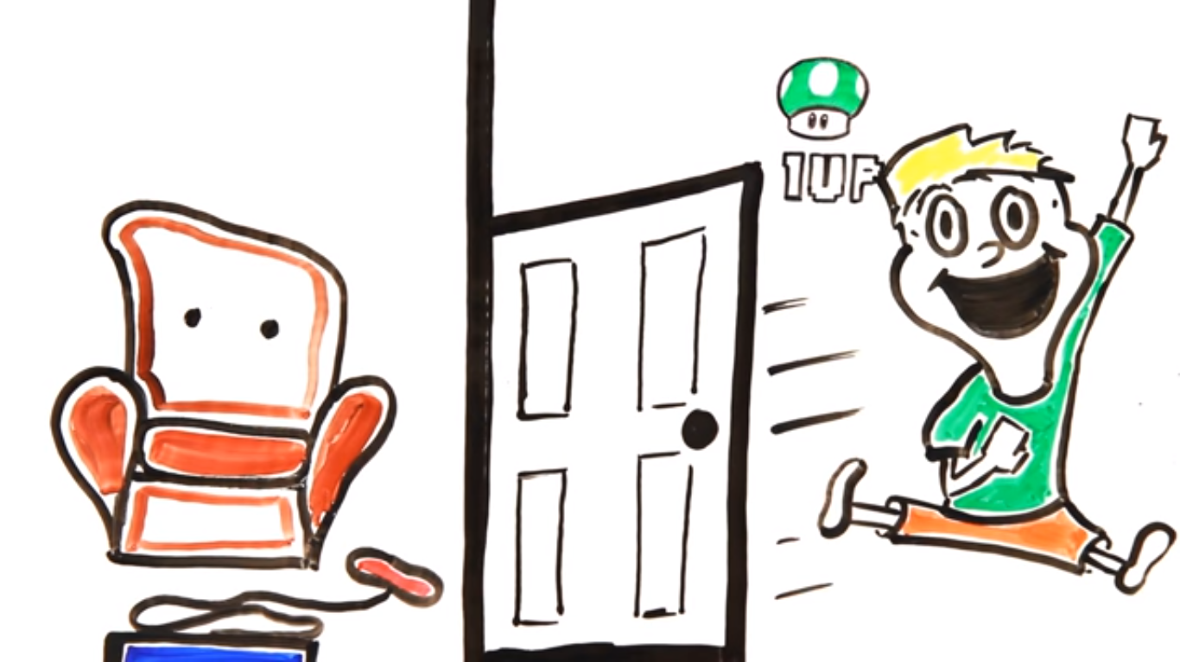

Slide 22


Slide 23
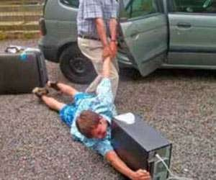

BUT PLEASE DO NOT GET ADDICTED
OR ELSE YOUR

Slide 24

THANK FOR
UR PATIENCE

